Slide 1
Capstone Project
(Supervised ML - Classification)
Bank Marketing Effective Prediction
By
Ajinkya Morade and Nitesh Gajakosh

Slide 2
CONTENTS
Introduction.
Problem Statement.
Explanation of Features
Exploratory Data Analysis
Feature Engineering
Model selection
SMOTE
Model Performances
Hyperparameter Tuning of models
ROC AUC Curve
Comparing algorithms/Models
Conclusions

Slide 3
INTRODUCTION
Bank marketing is the design structure, layout and delivery of customer-needed services worked out by checking out the corporate objectives of the bank and environmental constraints.
A term deposit is a fixed-term investment that includes the deposit of money into an account at a financial institution. Term deposit investments usually carry short-term maturities ranging from one month to a few years and will have varying levels of required minimum deposits.
The investor must understand when buying a term deposit that they can withdraw their funds only after the term ends. In some cases, the account holder may allow the investor early termination or withdrawal-if they give several days notification. Also, there will be a penalty assessed for early termination.

Slide 4
01
Make predictions
The classification Goal is to predict if the client will subscribe to a term deposit
Problem Statement
Model Development
02
Develop a Supervised Machine Learning Model using Classification.

Slide 5
Features
01
Age
02
Job -type of a job
Campaign-No. Of contacts performed during this campaign
13
03
Marital -Marital Status
04
Education
05
Default- Has credit in default?
Pdays- No. of days
14
06
Housing - Has housing Loan?
Previous-No. Of contacts performed before this campaign
15
07
Loan - Has a personal loan
08
Contact - Communication type
09
Month- Last contact month of the year
P-outcome -Outcome of previous marketing campaign
16
10
Day_of_week -Last day of week
Target variable(y) -Has client subscribed to term deposit
17
11
Duration -Last contact duration
12
Balance

Slide 6
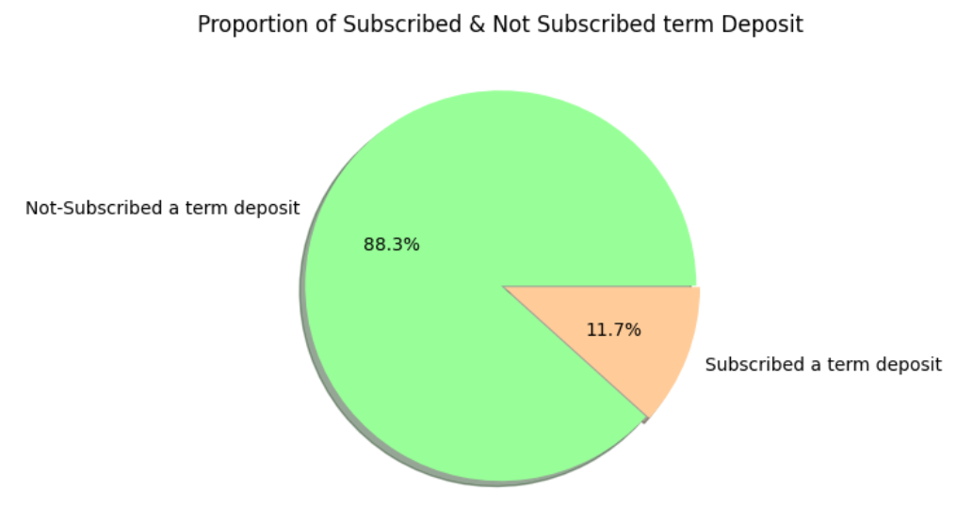
EDA
We can see from the above plot that the dataset is imbalanced, where the number of the non-subscribed class is close to 8 times the number of Subscribed class

Slide 7
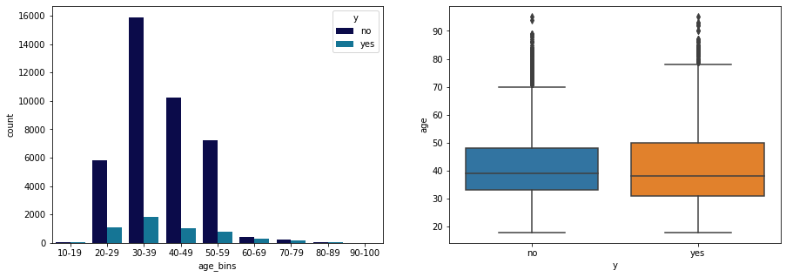
EDA
Majority of the customers are of the age group 30-39. Followed by 40-49 and 50-59
The Box Plot for the both subscribed and Not-subscribed customers looks the same
In No class,outliers are present above age 70 and For Yes class, Outliers are present above age 75

Slide 8
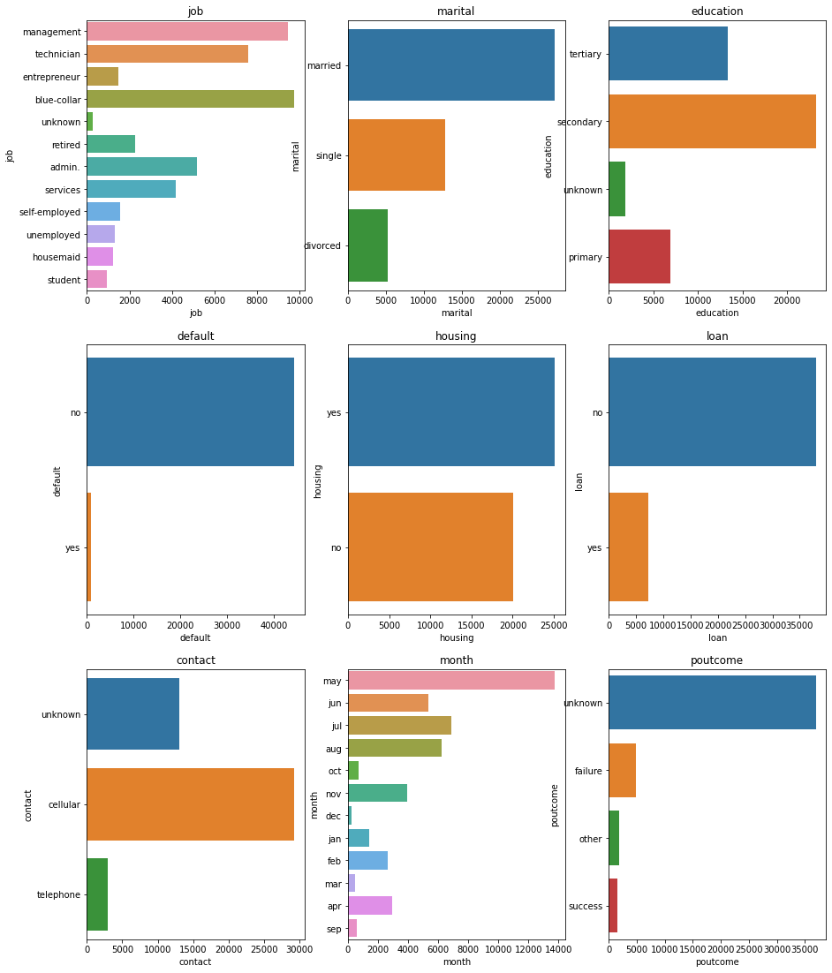
EDA Of Categorical Variables

Slide 9
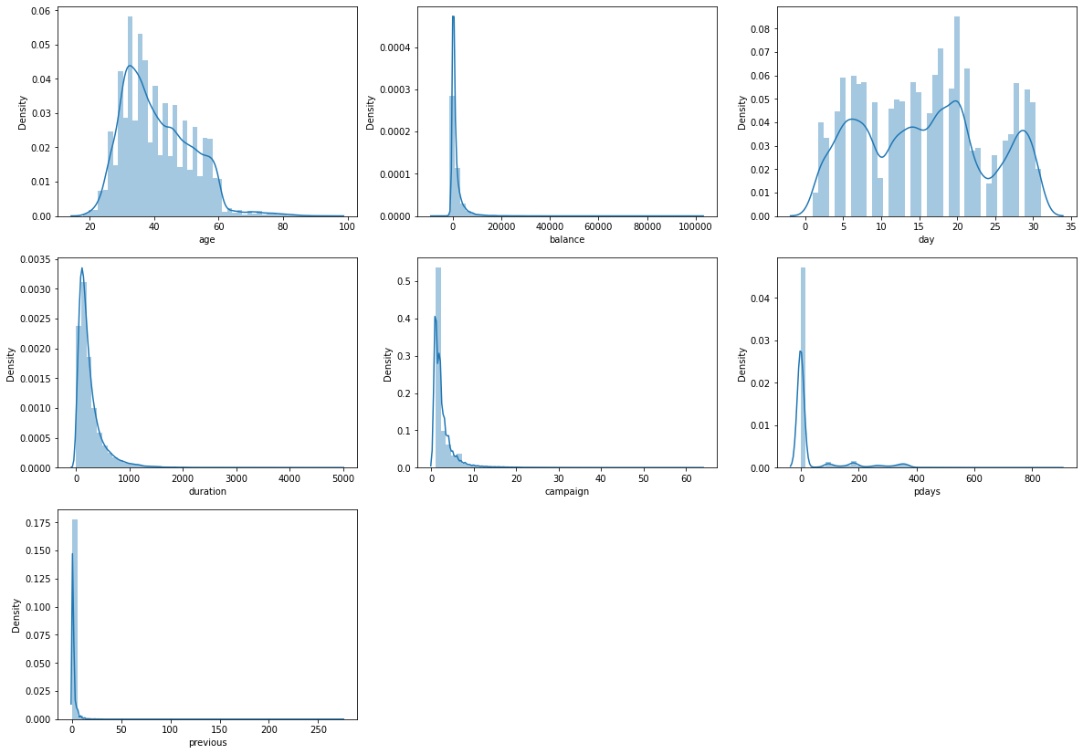
Distribution of Continuous Numerical Features
It seems age, days distributed normally.
Balance, duration, campaign, pdays and previous heavily skewed towards left and seems to be have some outliers.

Slide 10
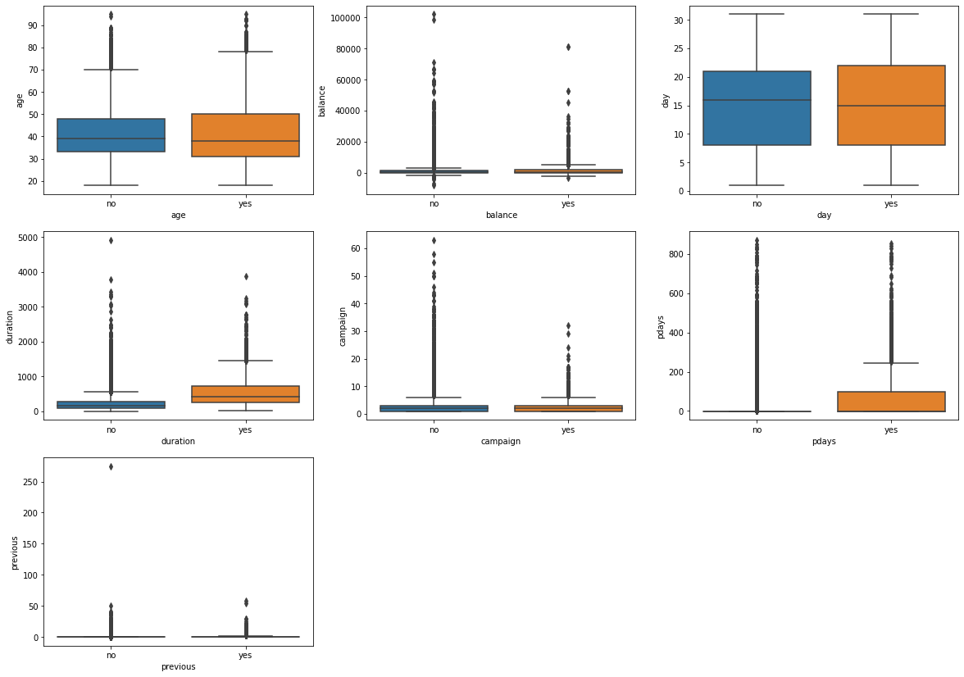
Relation between Continuous numerical Features and Labels
Client shows interest on deposit who had discussion for longer duration.

Slide 11
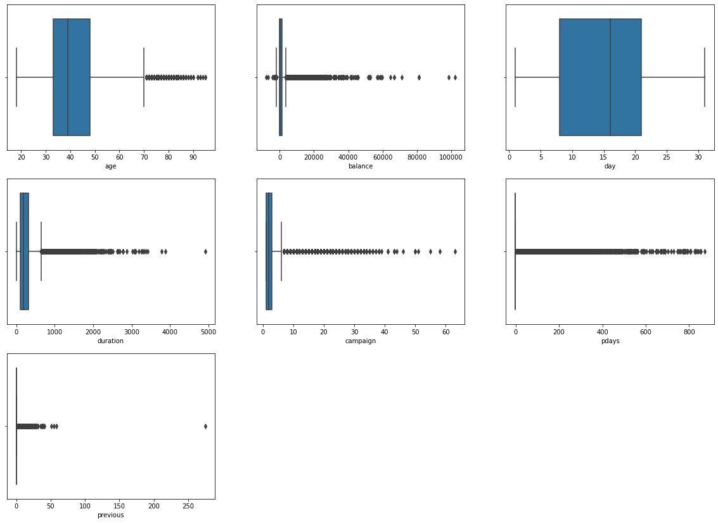
Find Outliers in numerical features
We can conclude that age, balance, duration, campaign, pdays and previous has some outliers.

Slide 12
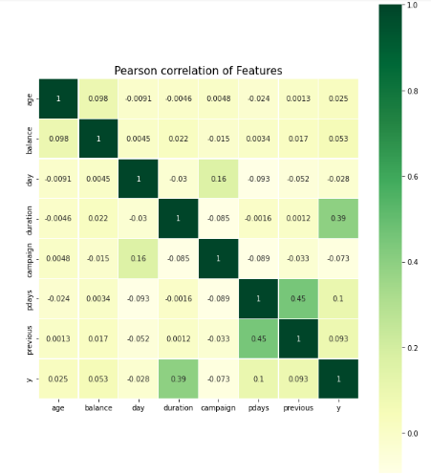
Correlation between numerical features
pdays and previous have high correlation of 0.45 and the dependent variable has highest correlation with duration .
It seems no feature is heavily correlated with other features.

Slide 13
Feature Engineering
01
Dropping columns
Default, pdays etc.
02
Label Encoding
Feature Engineering
Housing, Loan and y.
Getting Dummies
03
Job, Education, Marital Status, Contact, Month and Previous outcome

Slide 14
Model Selection
01
02
03
04
Decision Tree Classifier
Random Forest Classifier
Gradient Boosting Classifier
Logistic Regression
05
06
07
XGBoost Classifier
K Neighbors Classifier
Naive Bayes Classifier

Slide 15
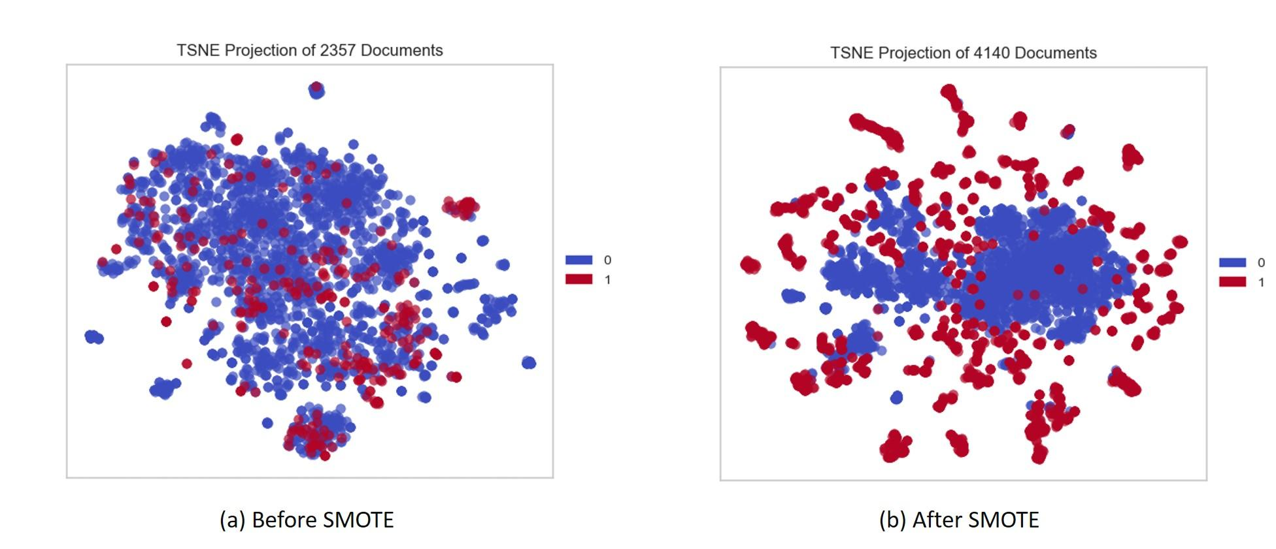
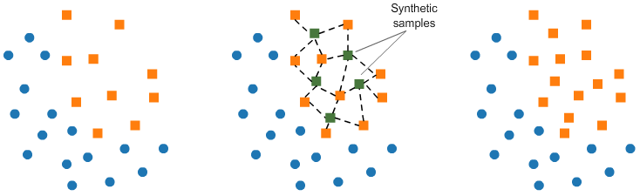
SMOTE
SMOTE: a powerful solution for imbalanced data.
SMOTE is an algorithm that performs data augmentation by creating synthetic data points based on the original data points. SMOTE can be seen as an advanced version of oversampling, or as a specific algorithm for data augmentation. The advantage of SMOTE is that you are not generating duplicates, but rather creating synthetic data points that are slightly different from the original data points.

Slide 16
The SMOTE algorithm works as follows:
Steps Involved
1. | You draw a random sample from minority class.
2. | For the observations in this sample, you will identify the k nearest neighbors.
3. | Take one of those neighbors and identify the vector between the current data point and the selected neighbor.
4. | You multiply the vector by a random number between 0 and 1.
5. | To obtain the synthetic data point, you add this to the current data point.

Slide 17
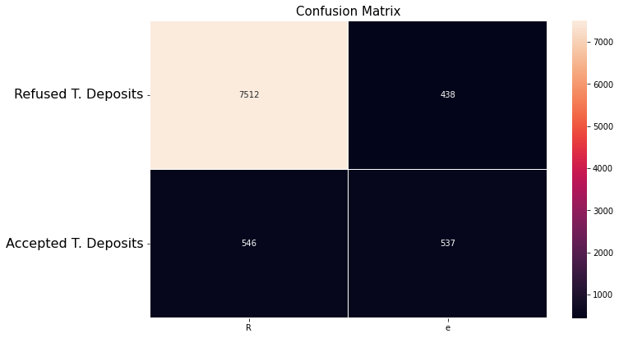
Random Forest Classifier
Classification report
Confusion matrix
Training accuracy Score | 1.0
Testing accuracy Score | 0.880
 | Precision | recall | F1-score | Support
0 | 0.94 | 0.93 | 0.94 | 8058
1 | 0.50 | 0.55 | 0.52 | 975
Accuracy |  |  | 0.880 | 9033
Macro avg | 0.72 | 0.74 | 0.73 | 9033
Weighted avg | 0.90 | 0.89 | 0.89 | 9033

Slide 18
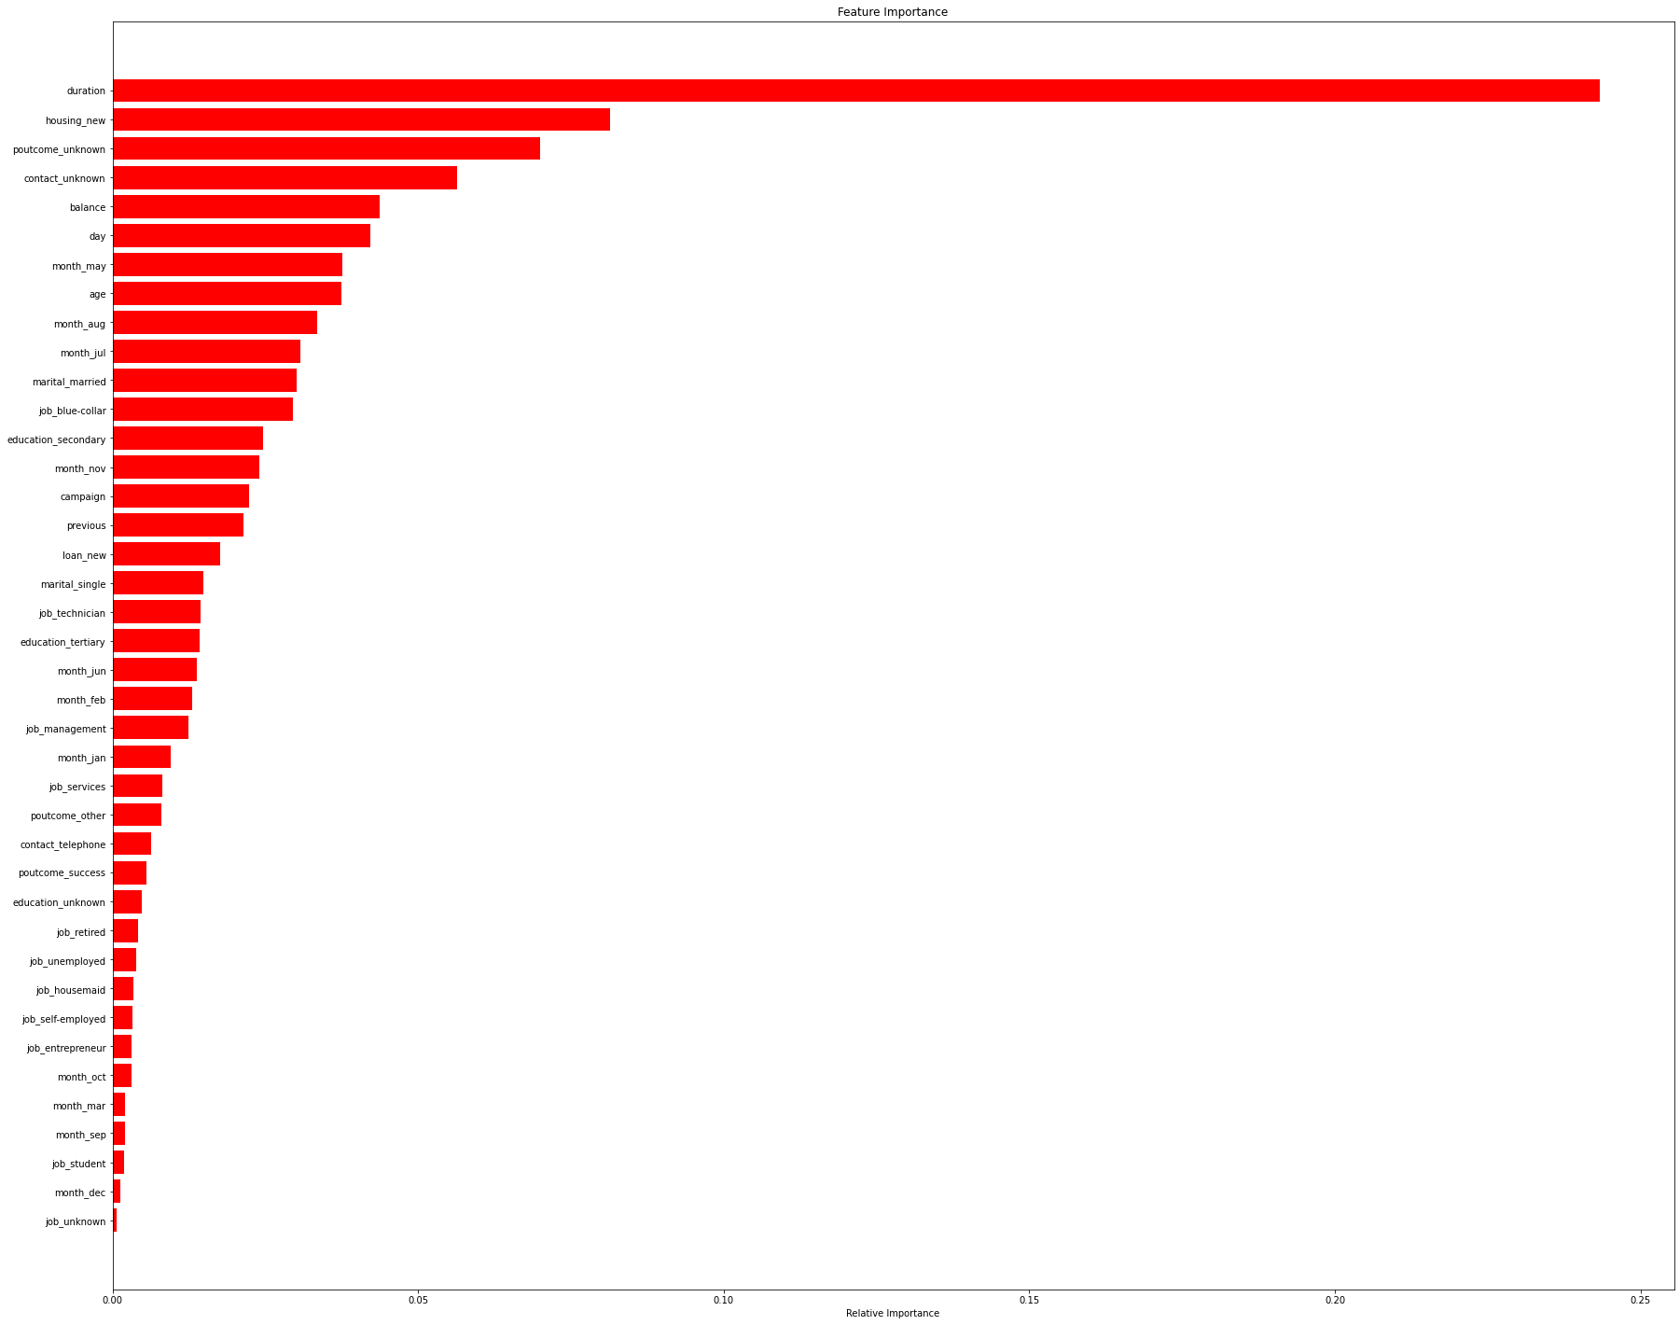
Feature Importance

Slide 19

Hyperparameter Tuning
Classification report
Confusion matrix
Training accuracy Score | 1.0
Testing accuracy Score | 0.8910660909996679
 | Precision | recall | F1-score | Support
0 | 0.95 | 0.93 | 0.94 | 8058
1 | 0.50 | 0.55 | 0.52 | 975
Accuracy |  |  | 0.89 | 9033
Macro avg | 0.72 | 0.74 | 0.73 | 9033
Weighted avg | 0.90 | 0.89 | 0.89 | 9033

Slide 20
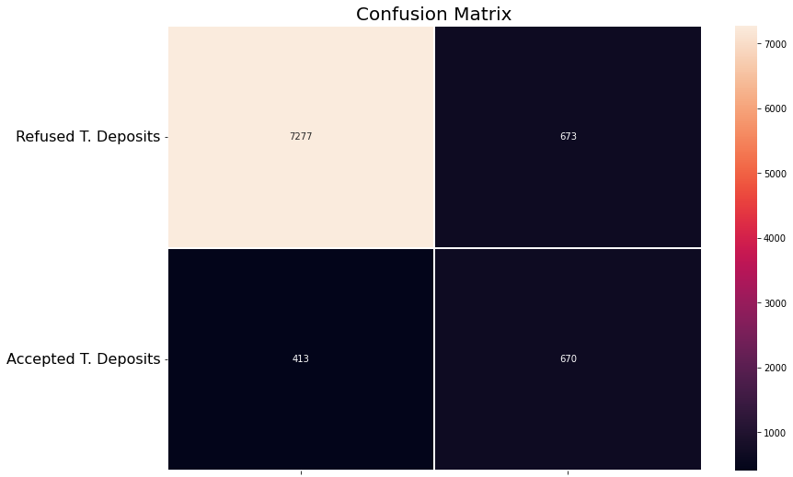
XG Boost Classifier
Classification report
Confusion matrix
Training accuracy Score | 0.93
Testing accuracy Score | 0.87
 | Precision | recall | F1-score | Support
0 | 0.92 | 0.95 | 0.93 | 7690
1 | 0.62 | 0.50 | 0.55 | 1343
Accuracy |  |  | 0.88 | 9033
Macro avg | 0.77 | 0.72 | 0.74 | 9033
Weighted avg | 0.87 | 0.88 | 0.87 | 9033

Slide 21
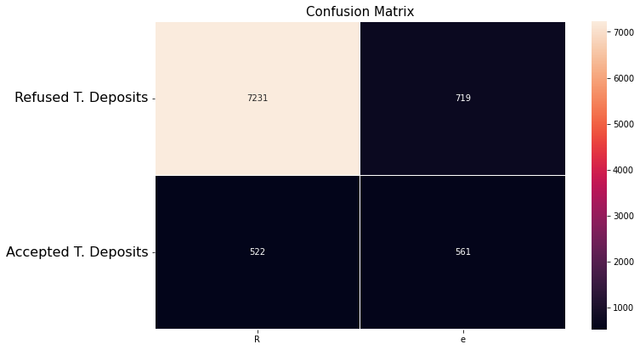
Gradient Boosting Classifier
Classification report
Confusion matrix
Training accuracy Score | 0.93
Testing accuracy Score | 0.88
 | Precision | recall | F1-score | Support
0 | 0.91 | 0.93 | 0.93 | 7753
1 | 0.52 | 0.44 | 0.48 | 1280
Accuracy |  |  | 0.88 | 9033
Macro avg | 0.71 | 0.69 | 0.70 | 9033
Weighted avg | 0.85 | 0.86 | 0.86 | 9033

Slide 22
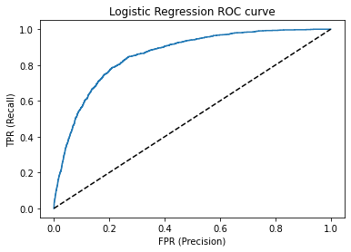
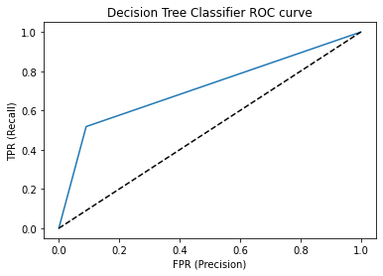
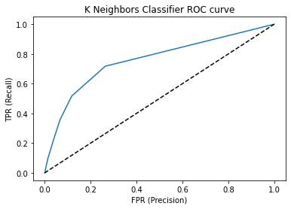
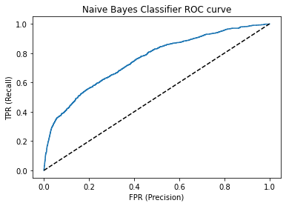
ROC AUC Curve
Score: 85.68 %
Score: 71.38 %
Score: 75.73 %
Score: 75.36 %

Slide 23
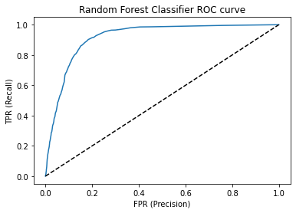
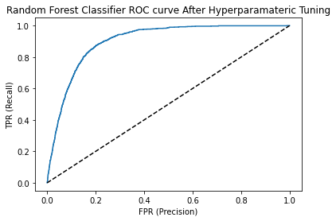

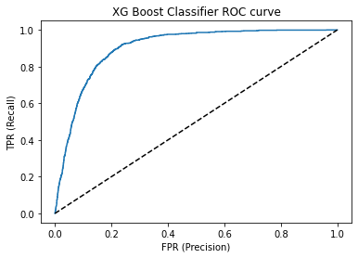
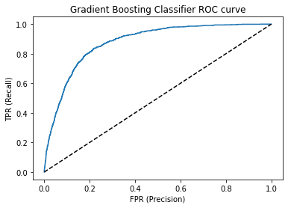
ROC AUC Curve (Top 3 accuracy models)
Score: 90.03 %
Score: 91.56 %
Score: 90.30 %
Score: 87.61 %

Slide 24
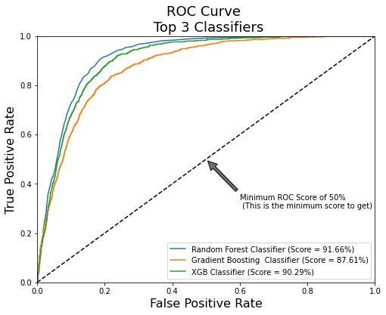

ROC AUC Curve for top 3 Models and its Performance

Slide 25
Comparison Of Models
Sr.no. | Model Name | Train Accuracy | Test Accuracy | F1 Score class 0 | F1 Score class 1 | ROC AUC Score
1 | Logistic Regression | 0.92 | 0.87 | 0.93 | 0.46 | 0.8568
2 | Random Forest Classifier | 1 | 0.89 | 0.94 | 0.52 | 0.9166
3 | Gradient Boosting Classifer | 0.93 | 0.88 | 0.93 | 0.48 | 0.8761
4 | XG Boosting Classifier | 0.93 | 0.88 | 0.93 | 0.55 | 0.9029
5 | Decision Tree Classifier | 1 | 0.86 | 0.92 | 0.47 | 0.7096
6 | Naïve Byer Classifier | 0.84 | 0.81 | 0.89 | 0.38 | 0.7536
7 | K Neighbors Classifier | 0.94 | 0.86 | 0.92 | 0.39 | 0.7573

Slide 26
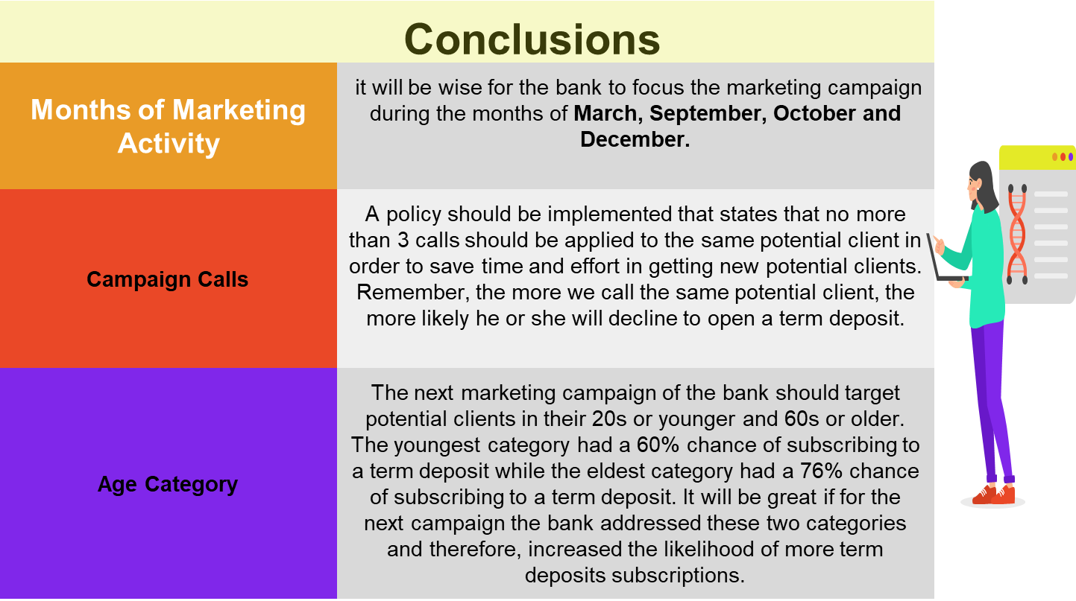

Slide 27
Thank You

